Slide 1
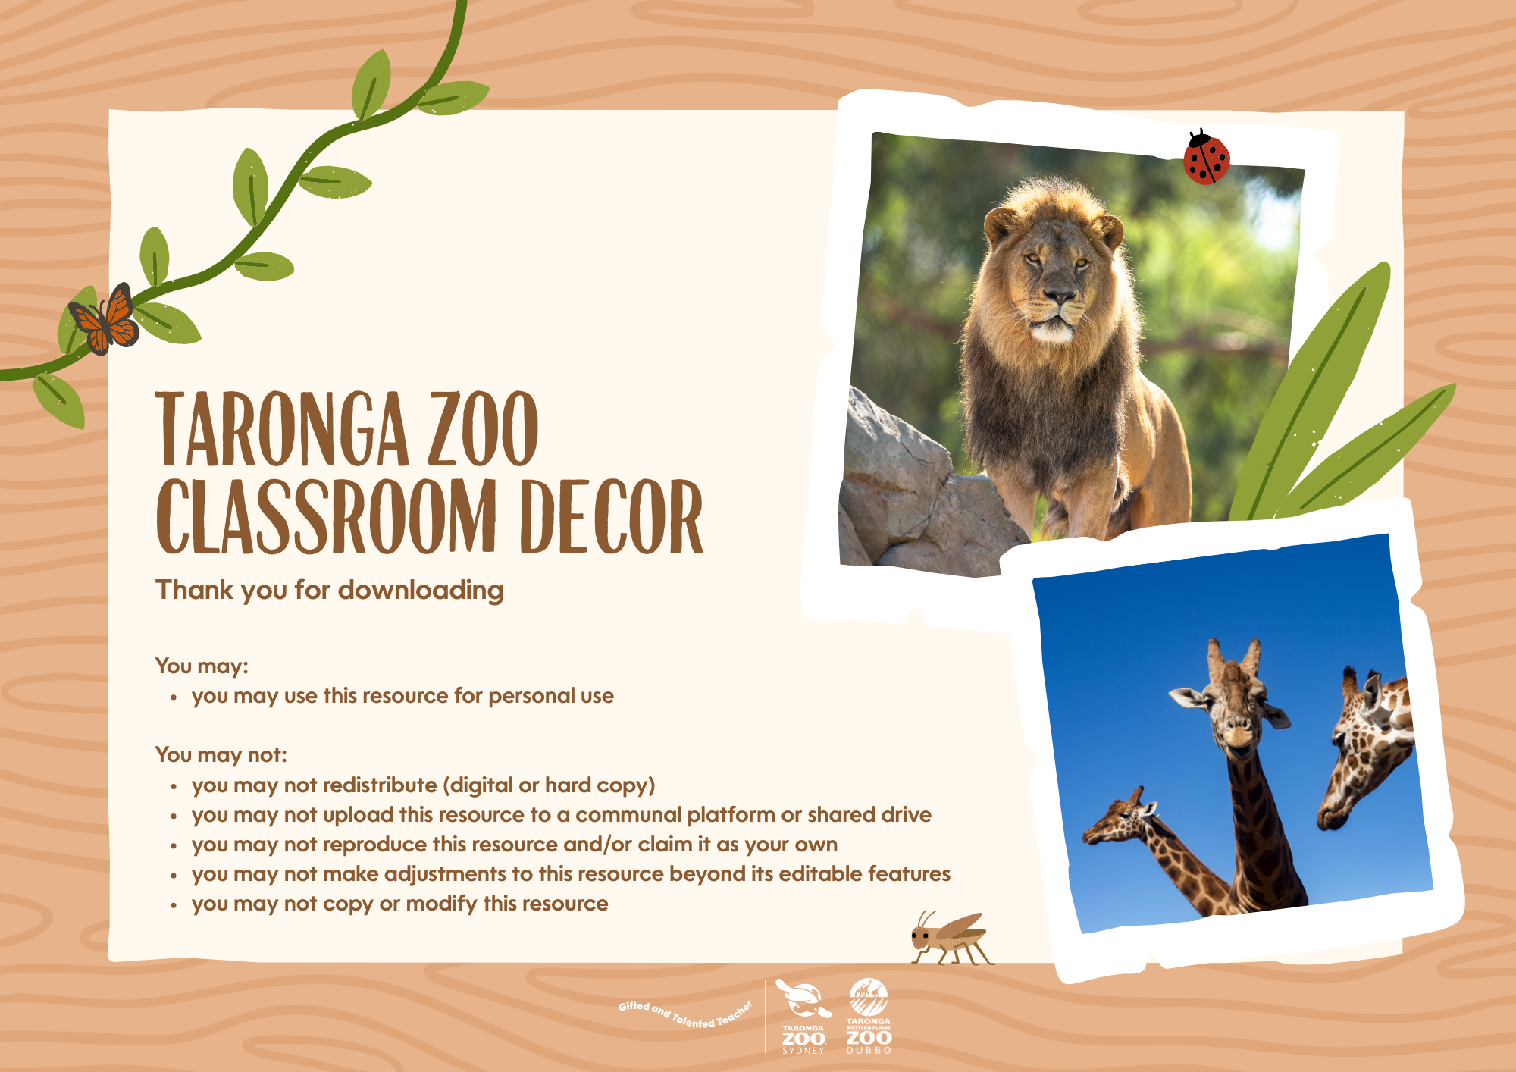

Slide 2
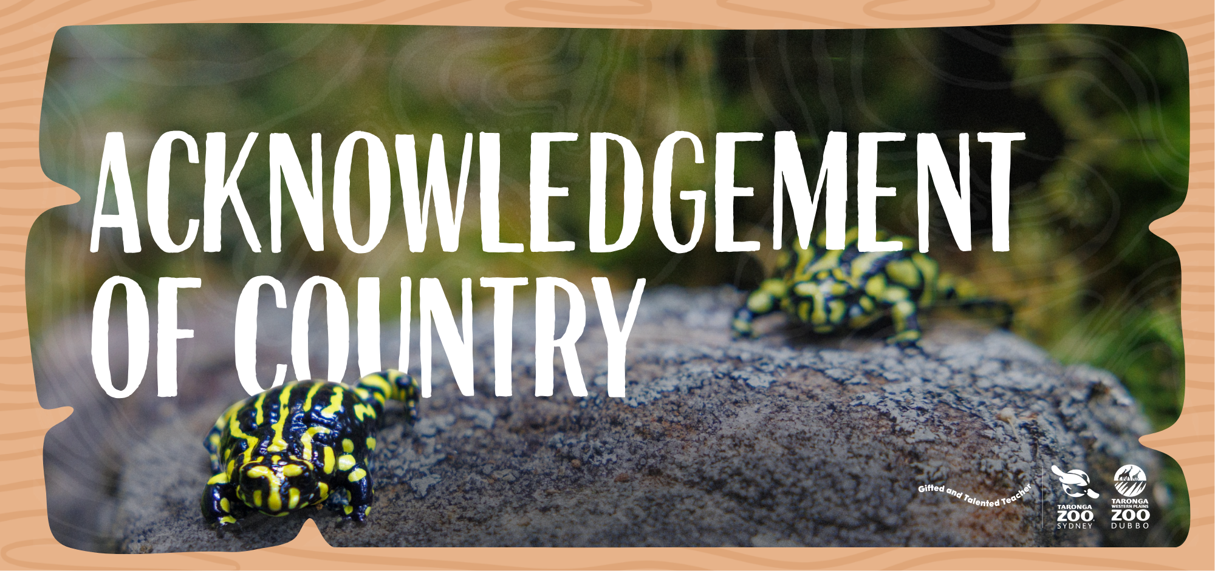

Slide 3
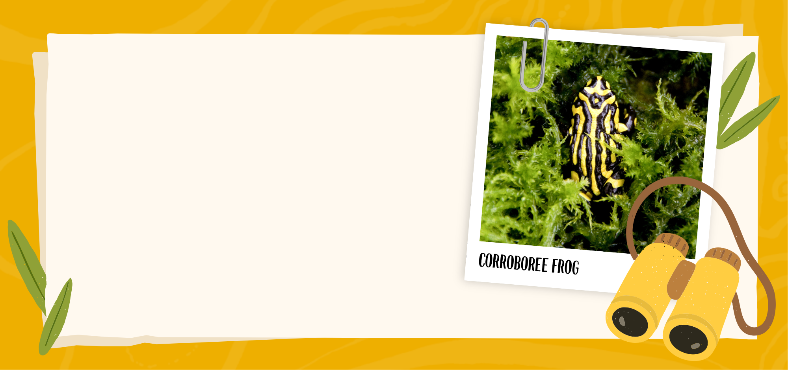
We acknowledge all First Peoples of this land and celebrate their enduring connections to Country, knowledge and stories.
We pay our respects to Elders and ancestors of the Aboriginal and Torres Strait Islander communities.
The Corroboree Frog, also known as 'Gyak’ in the local language, is an important totem for the Walgalu people and has strong links to Aboriginal culture.

