Slide 1


Slide 2


Slide 3
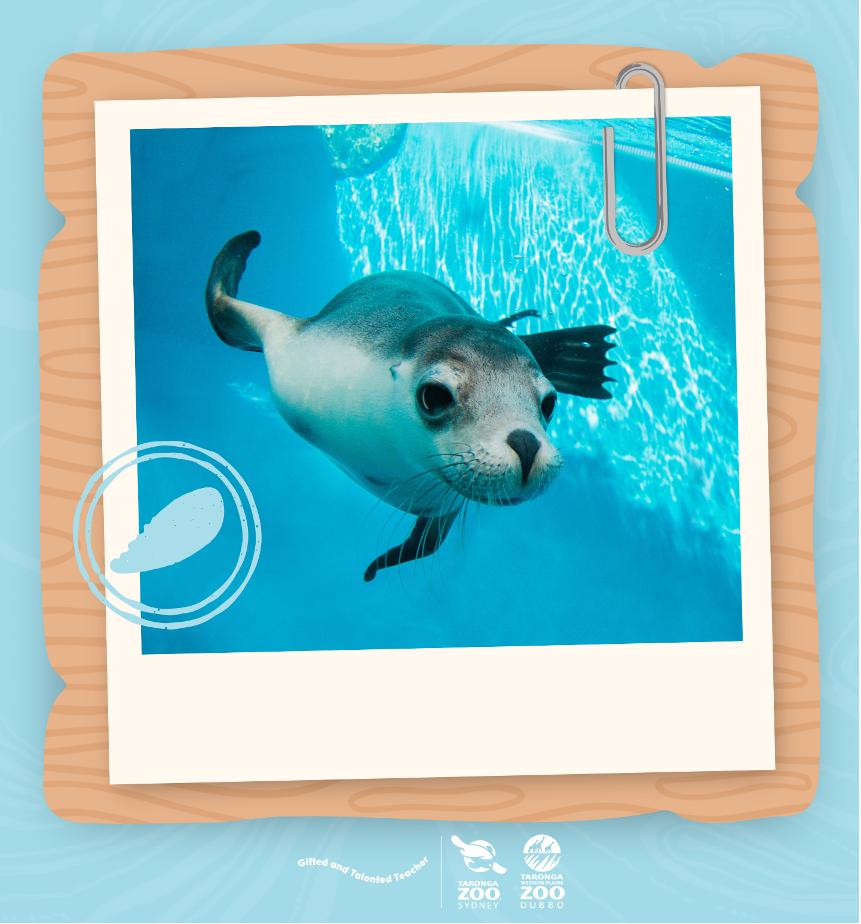
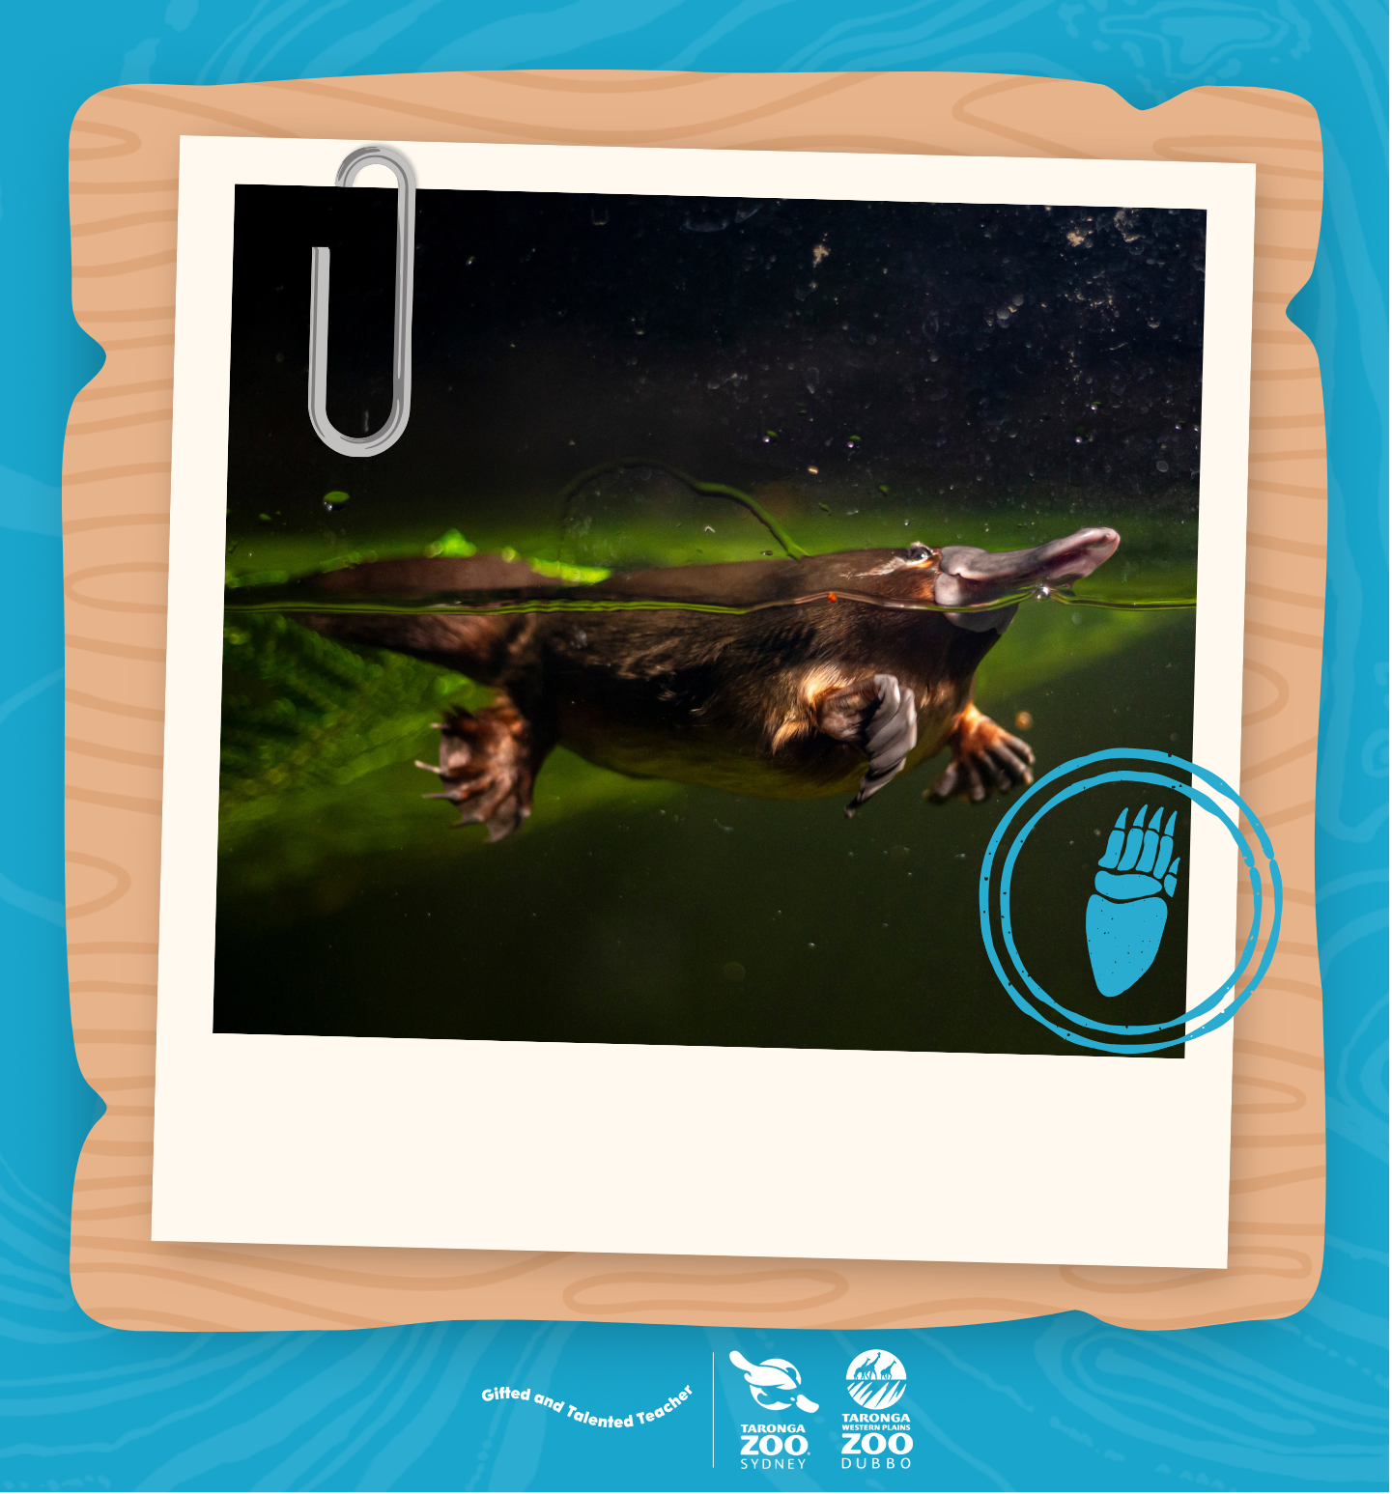

I am playful.
I am peaceful.
I am calm.

Slide 4



I am friendly.
I am fun.
I am brave.

Slide 5
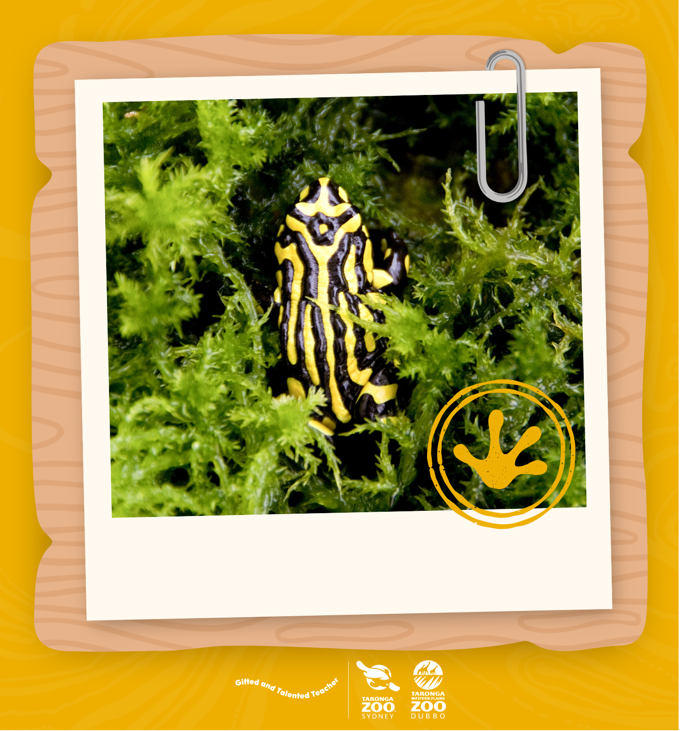

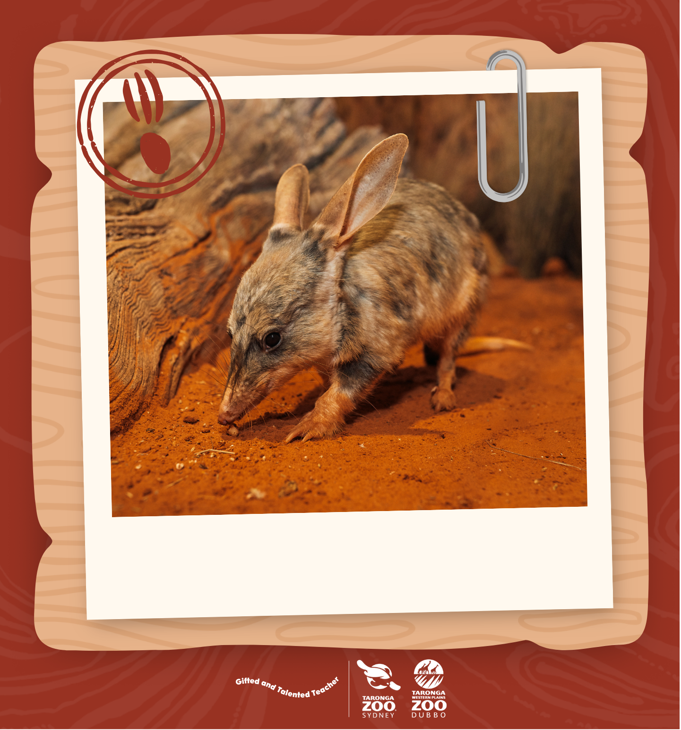
I am unique.
I am clever.
I am curious.

Slide 6
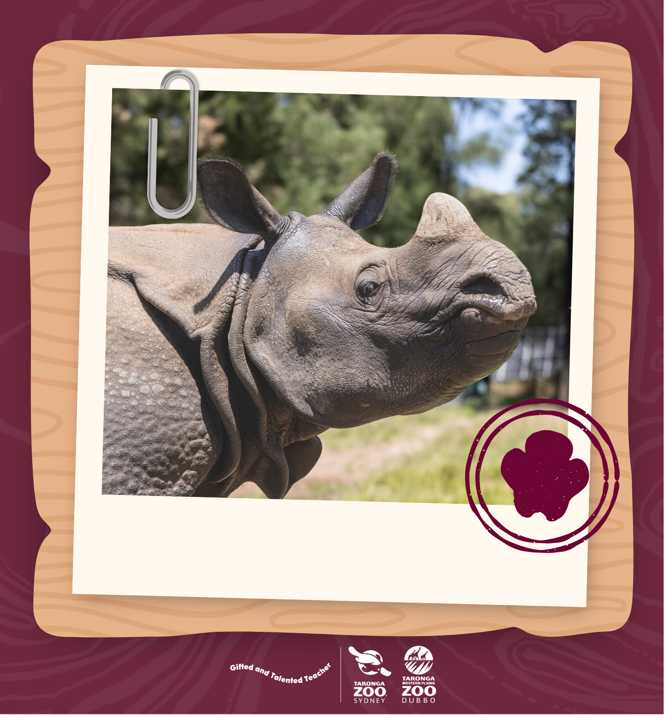
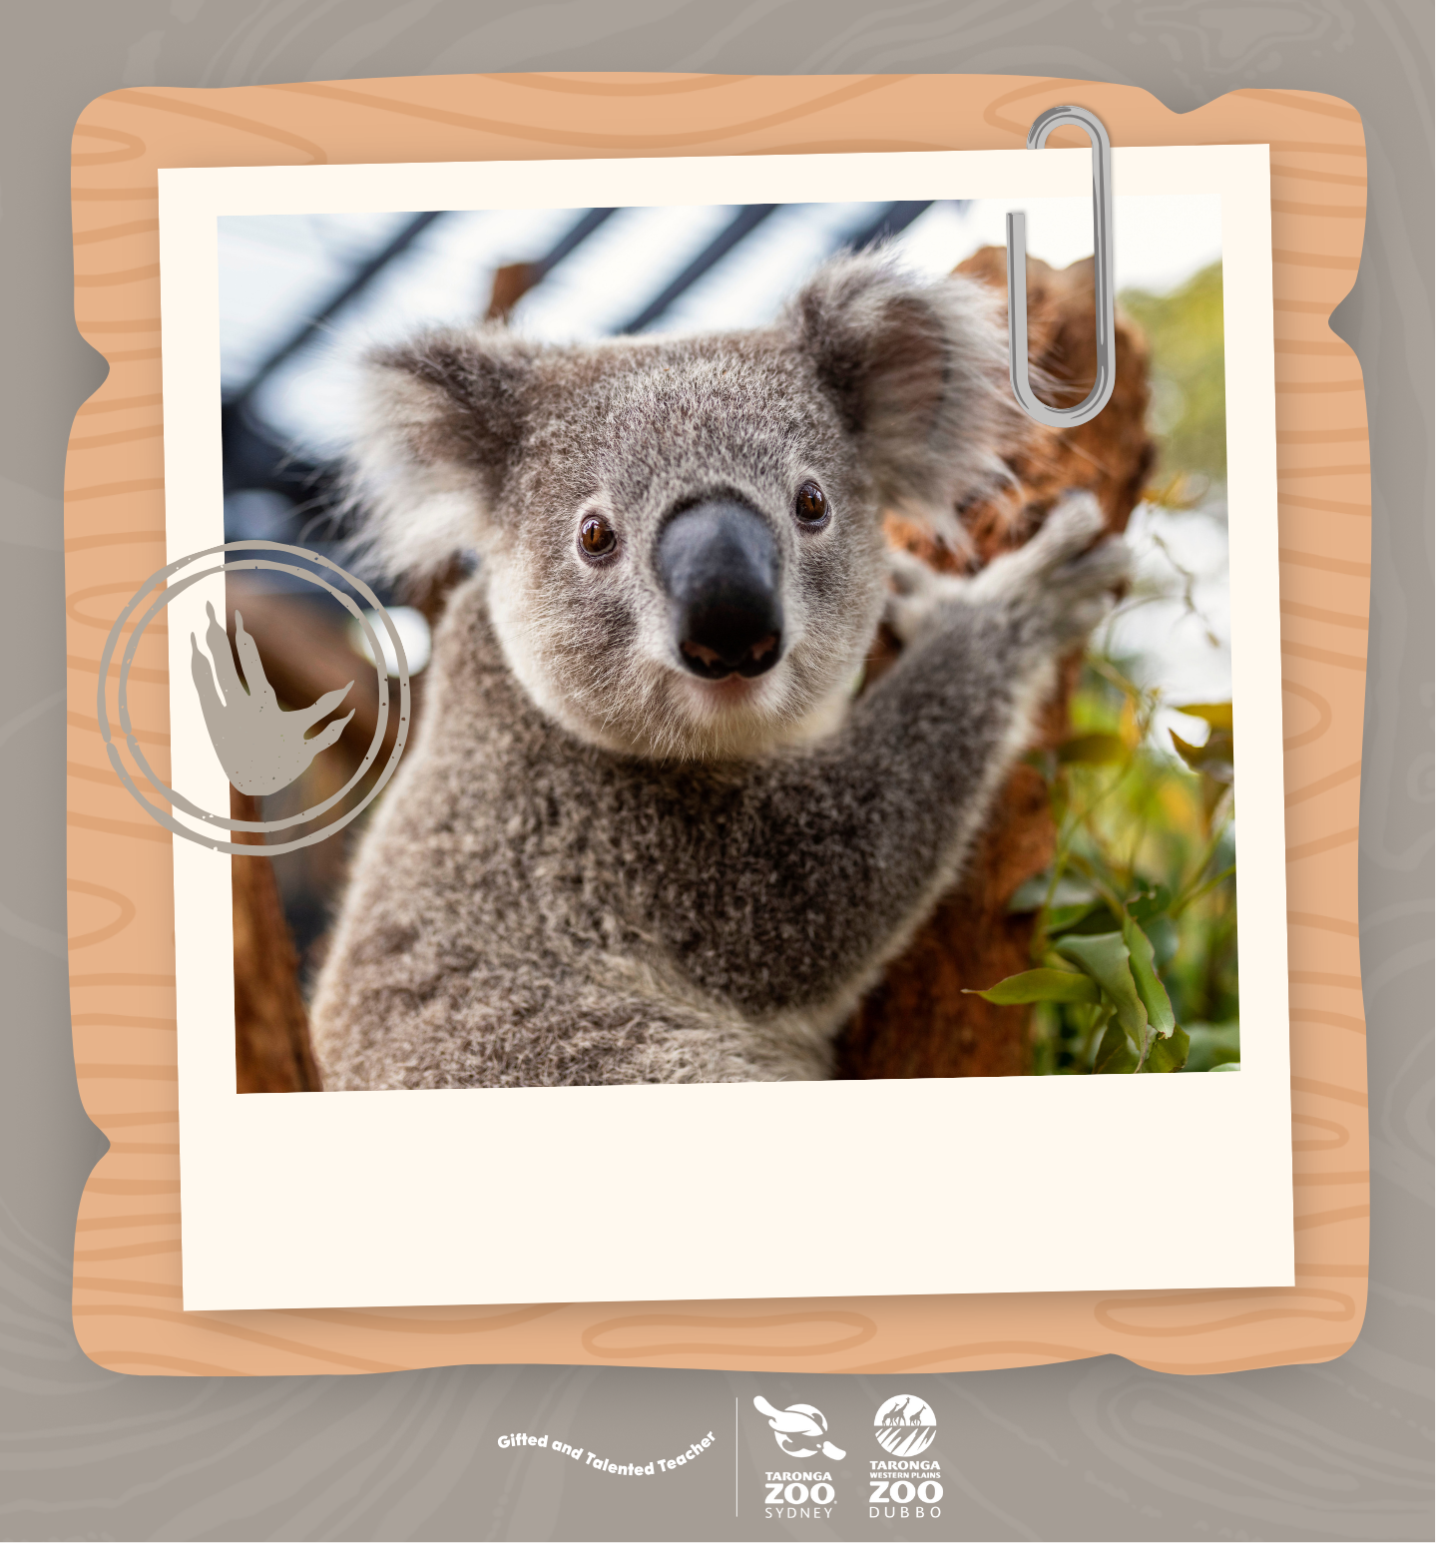
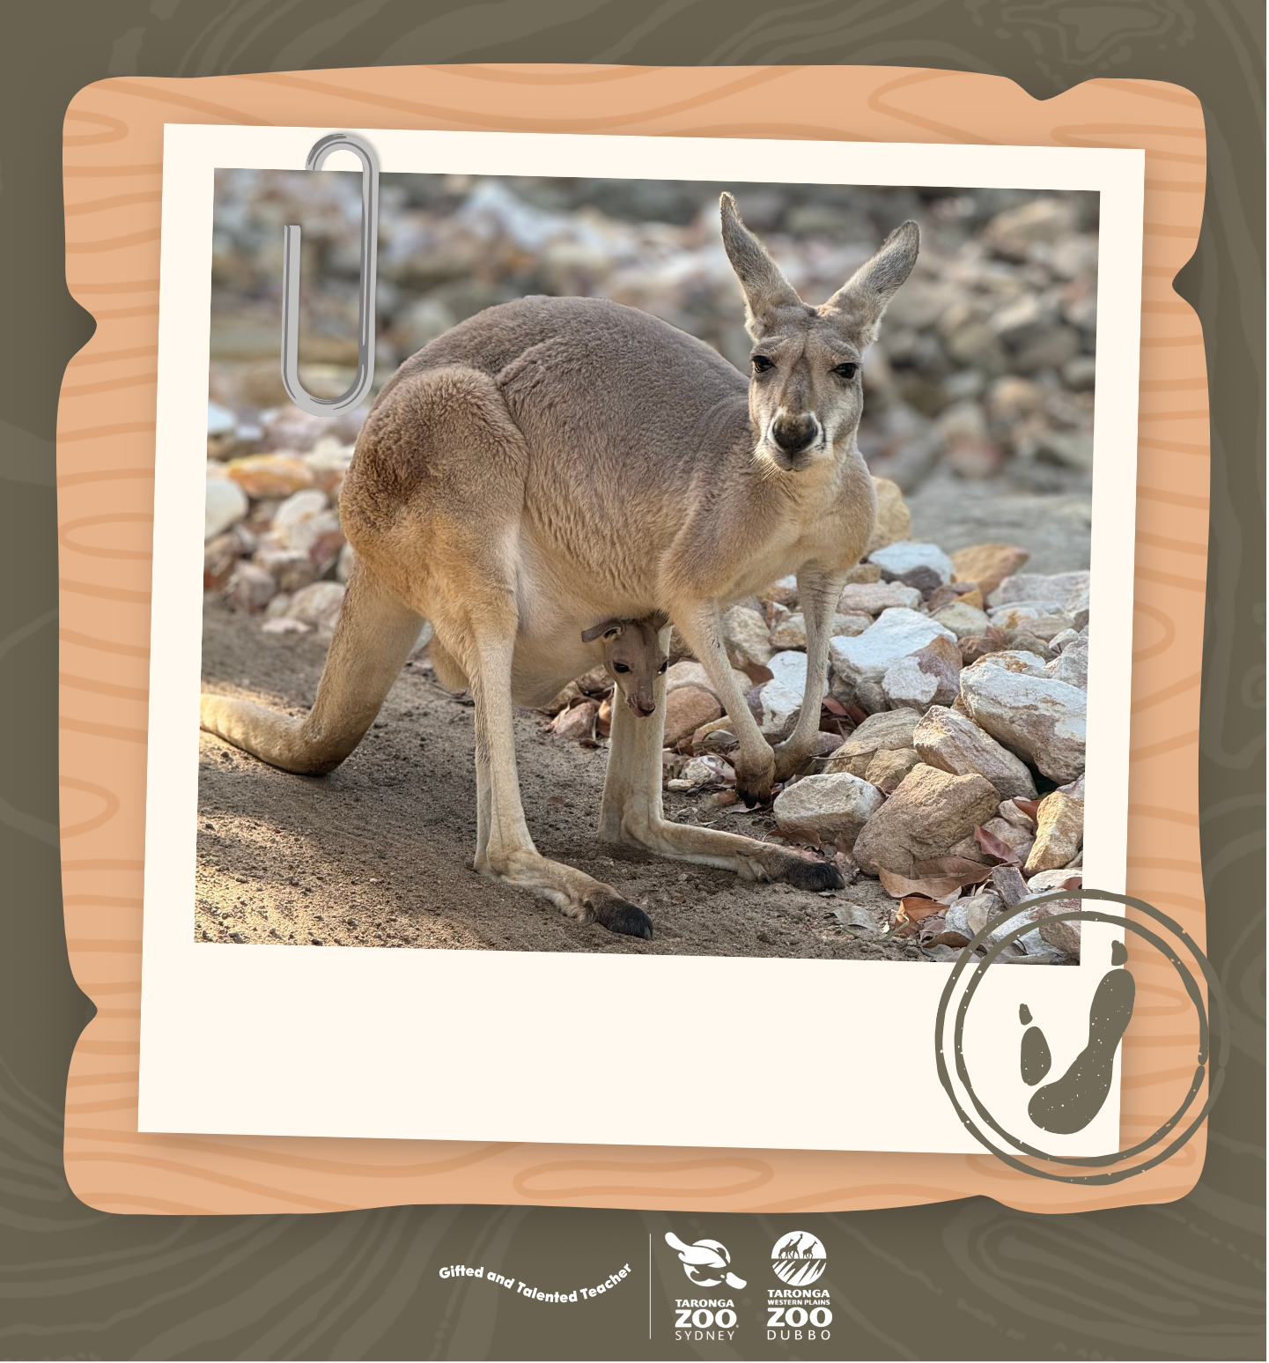
I am powerful.
I am independent.
I am strong.

