Slide 1


Slide 2
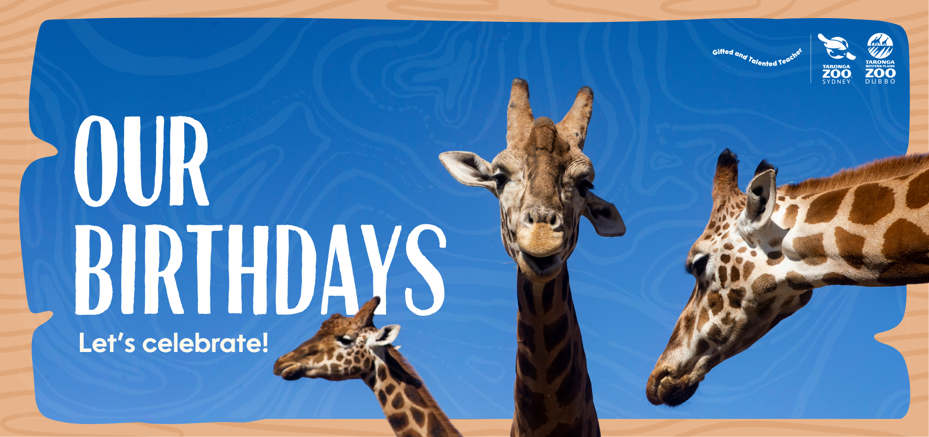

Slide 3
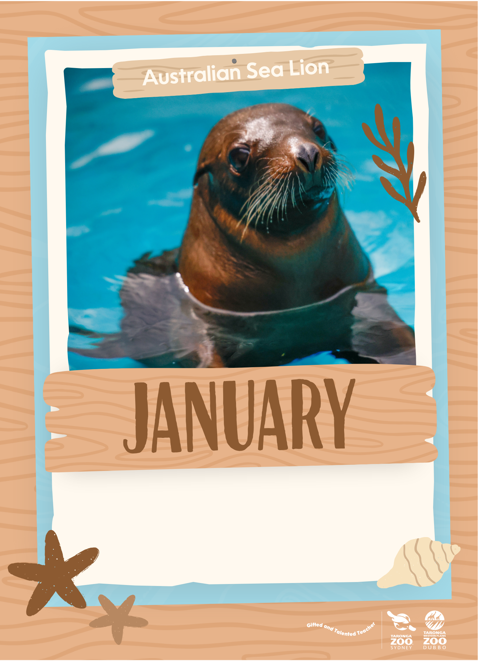
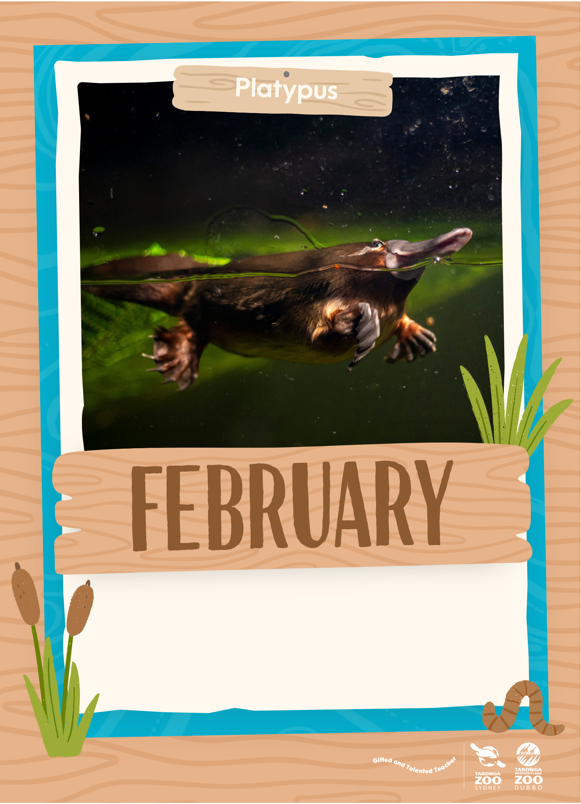

Slide 4
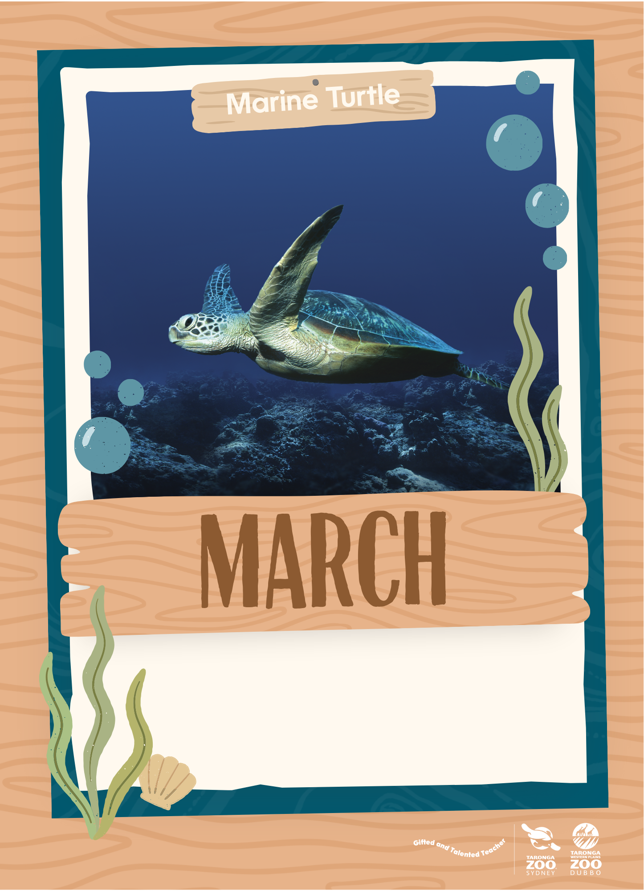
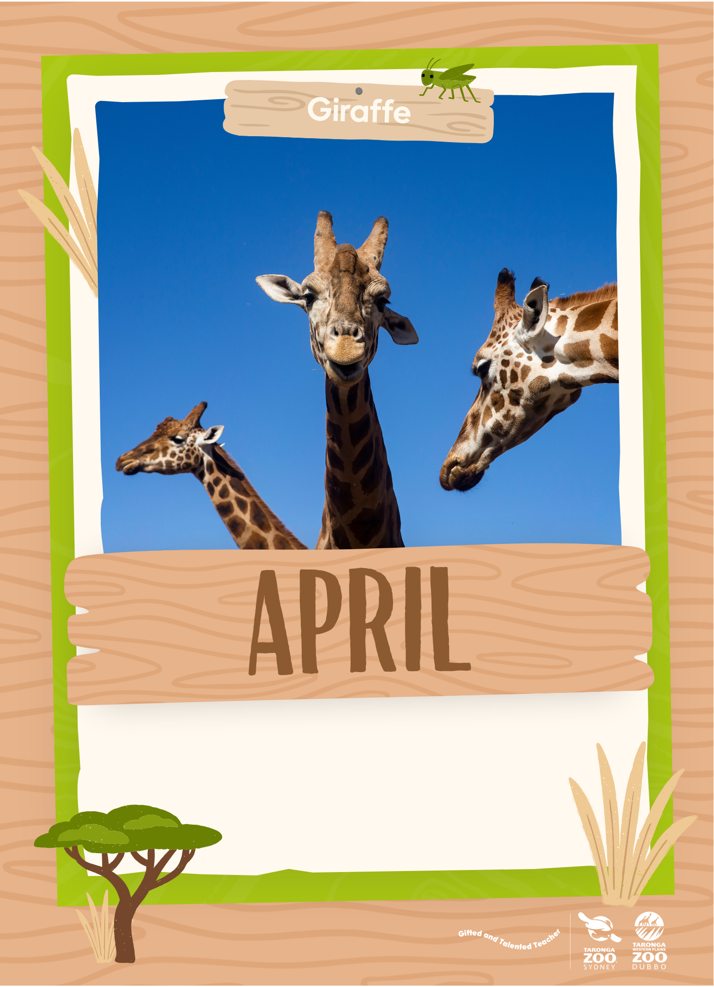

Slide 5
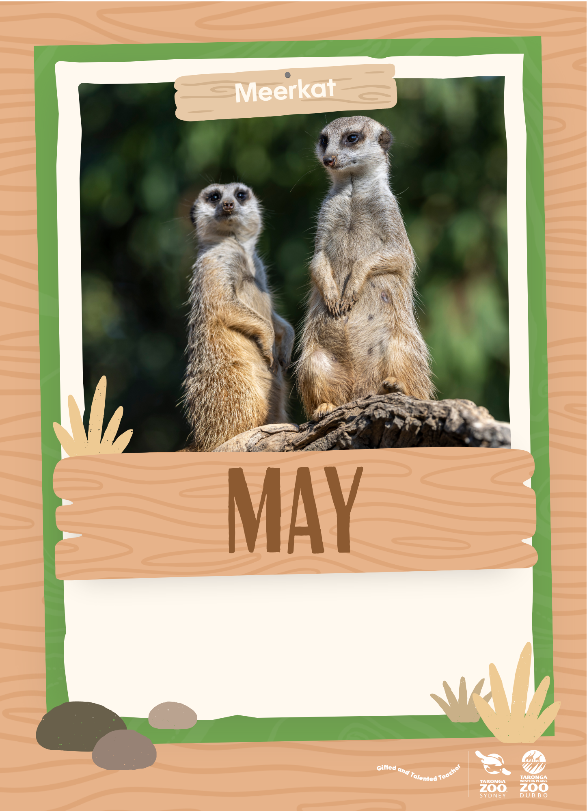
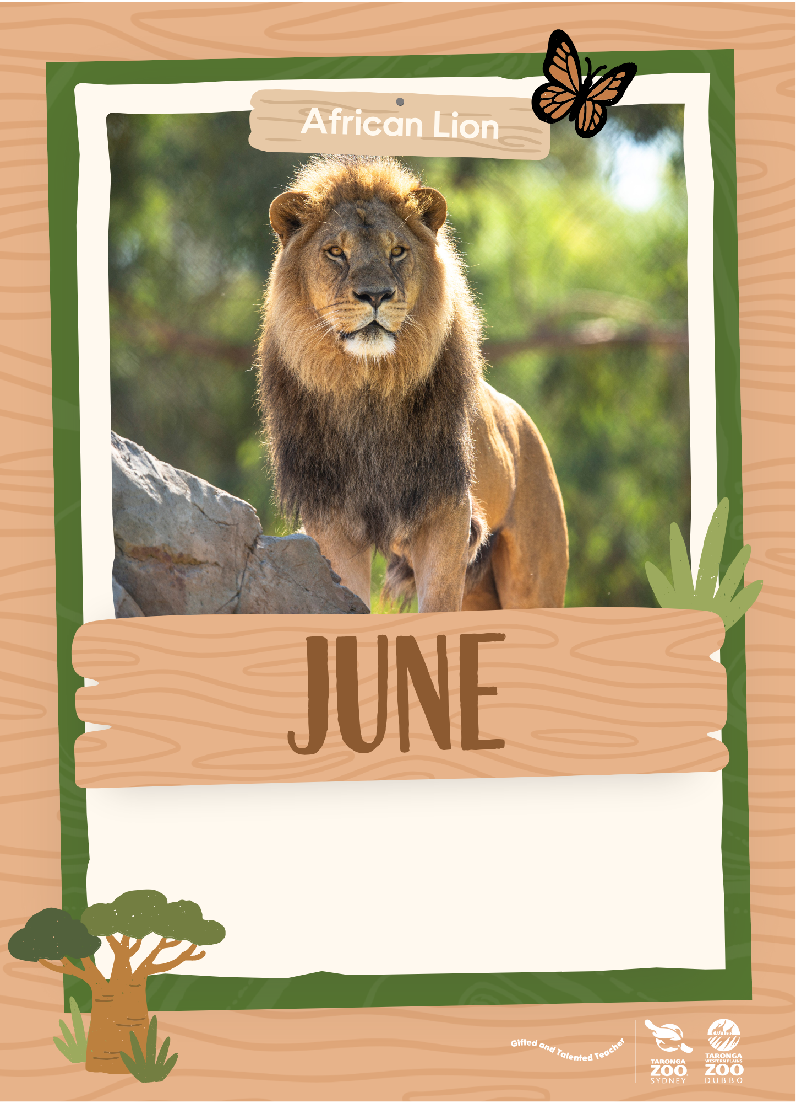

Slide 6
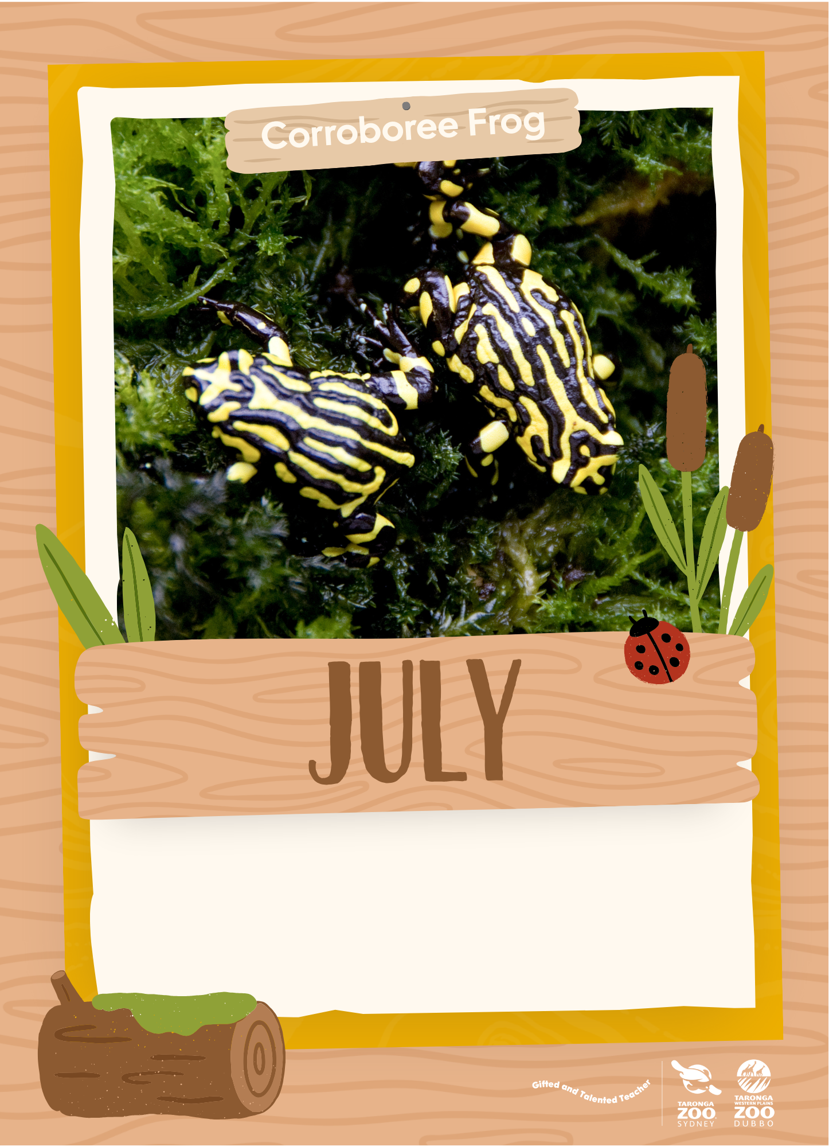
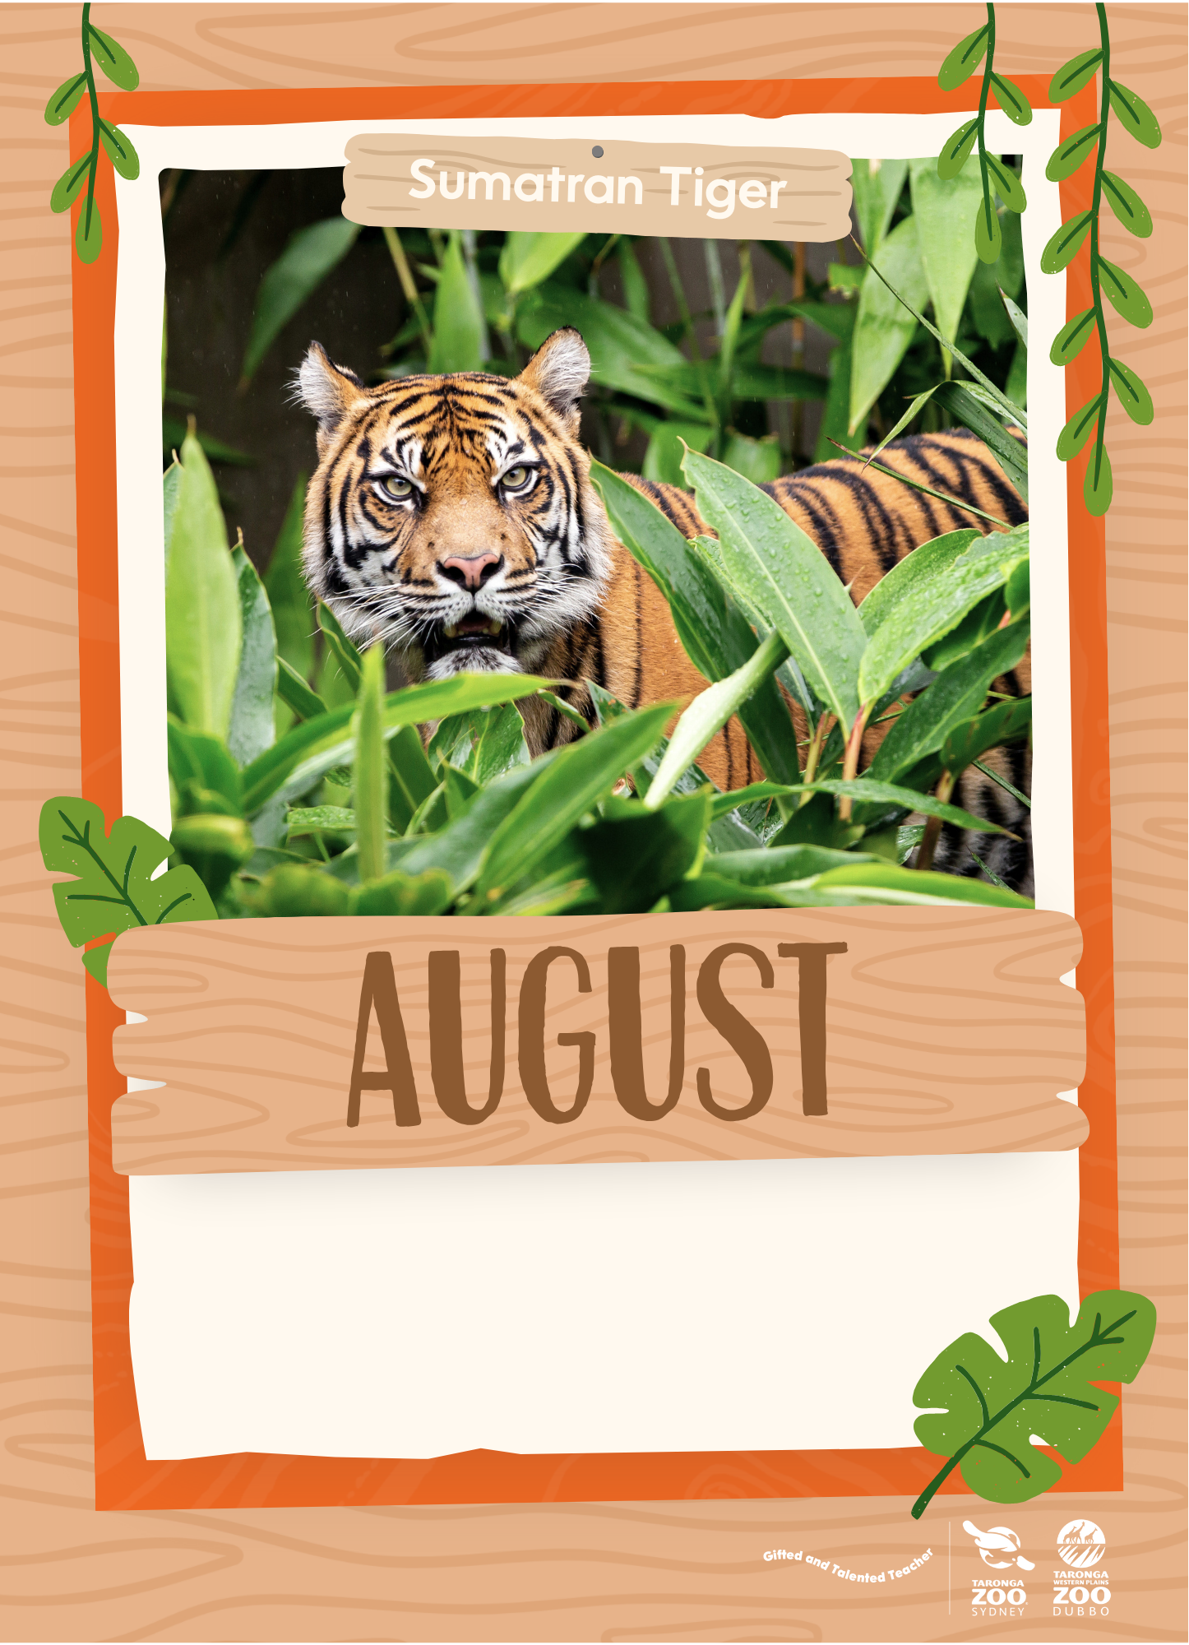

Slide 7
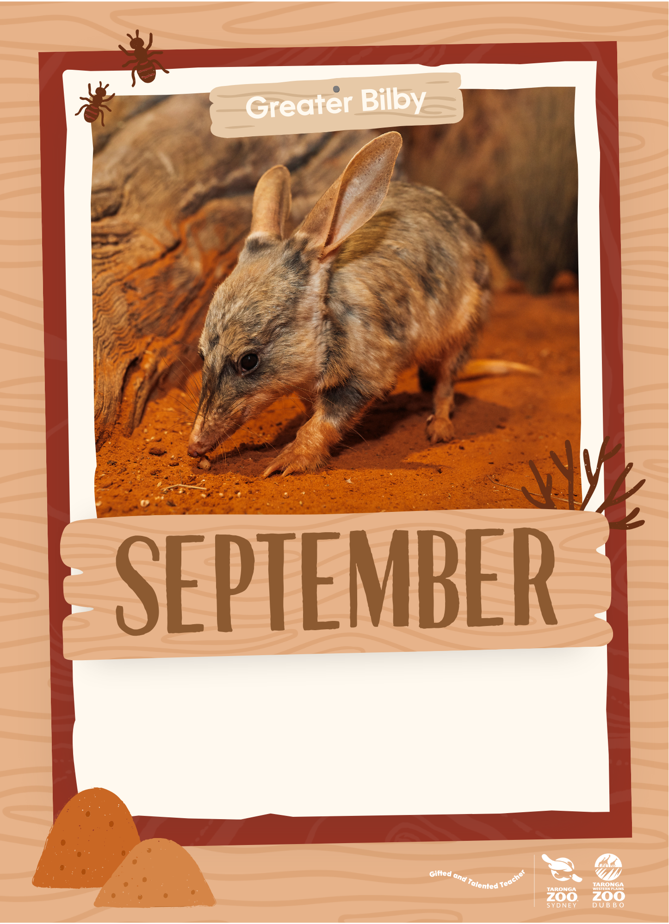
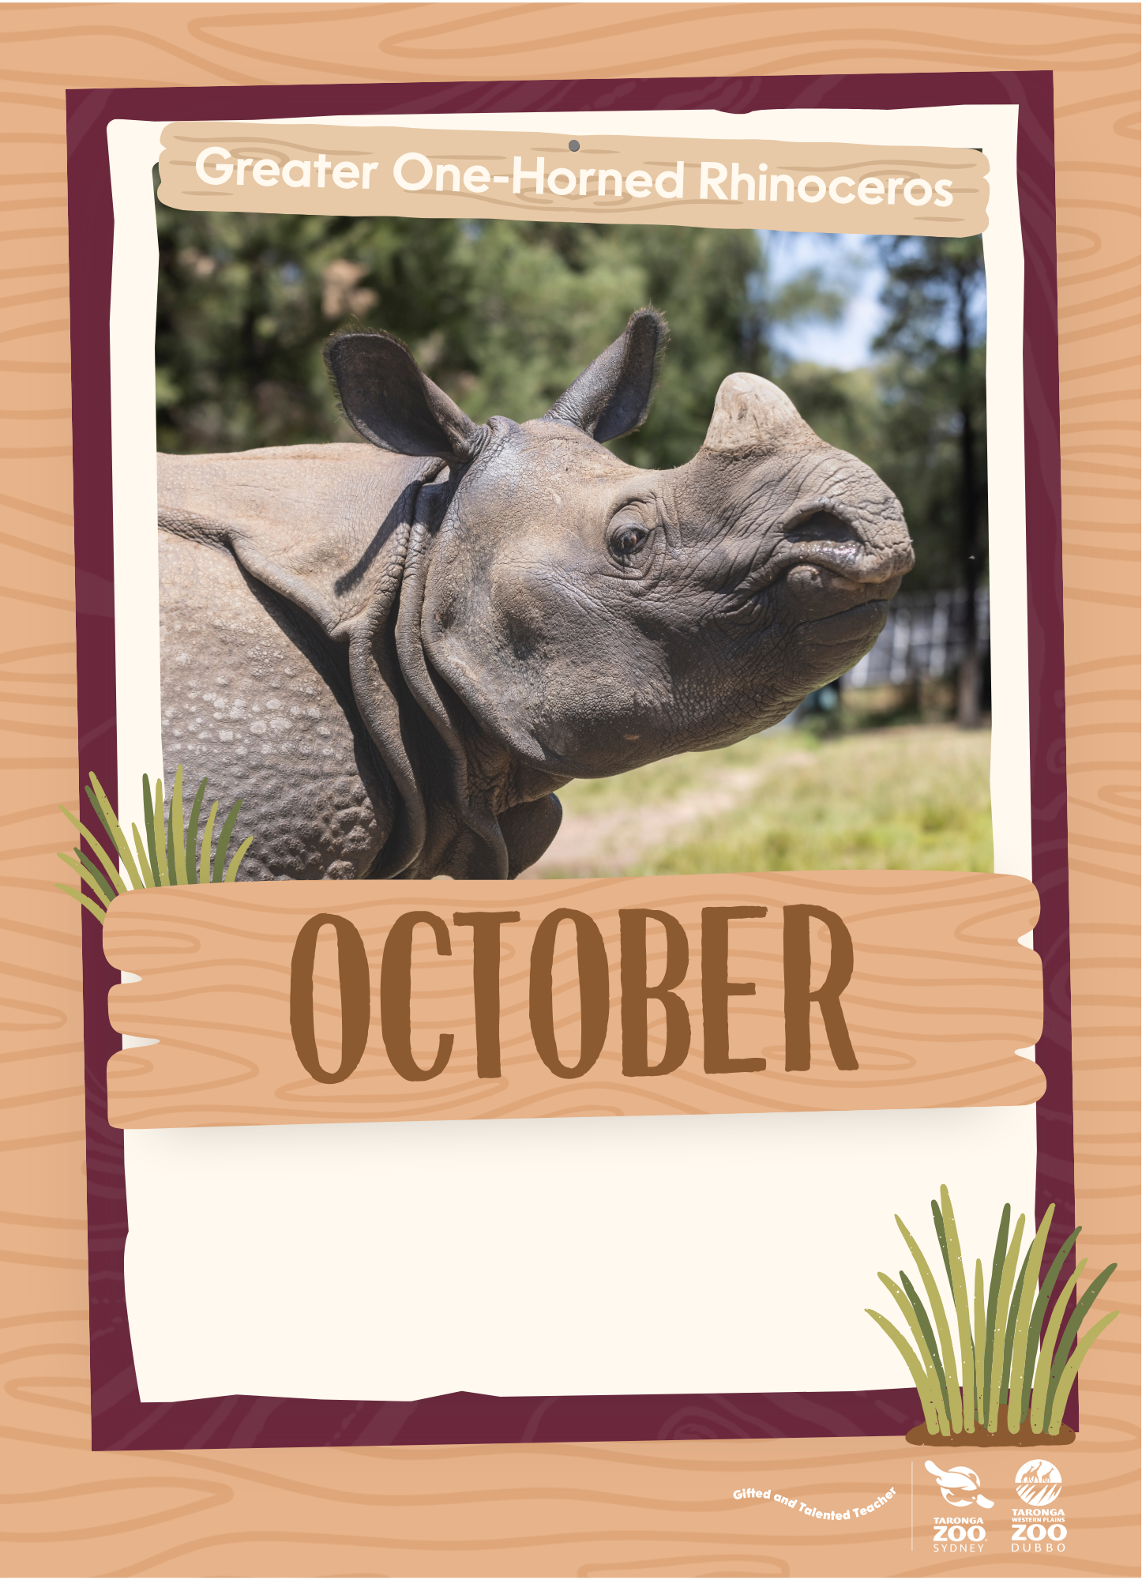

Slide 8
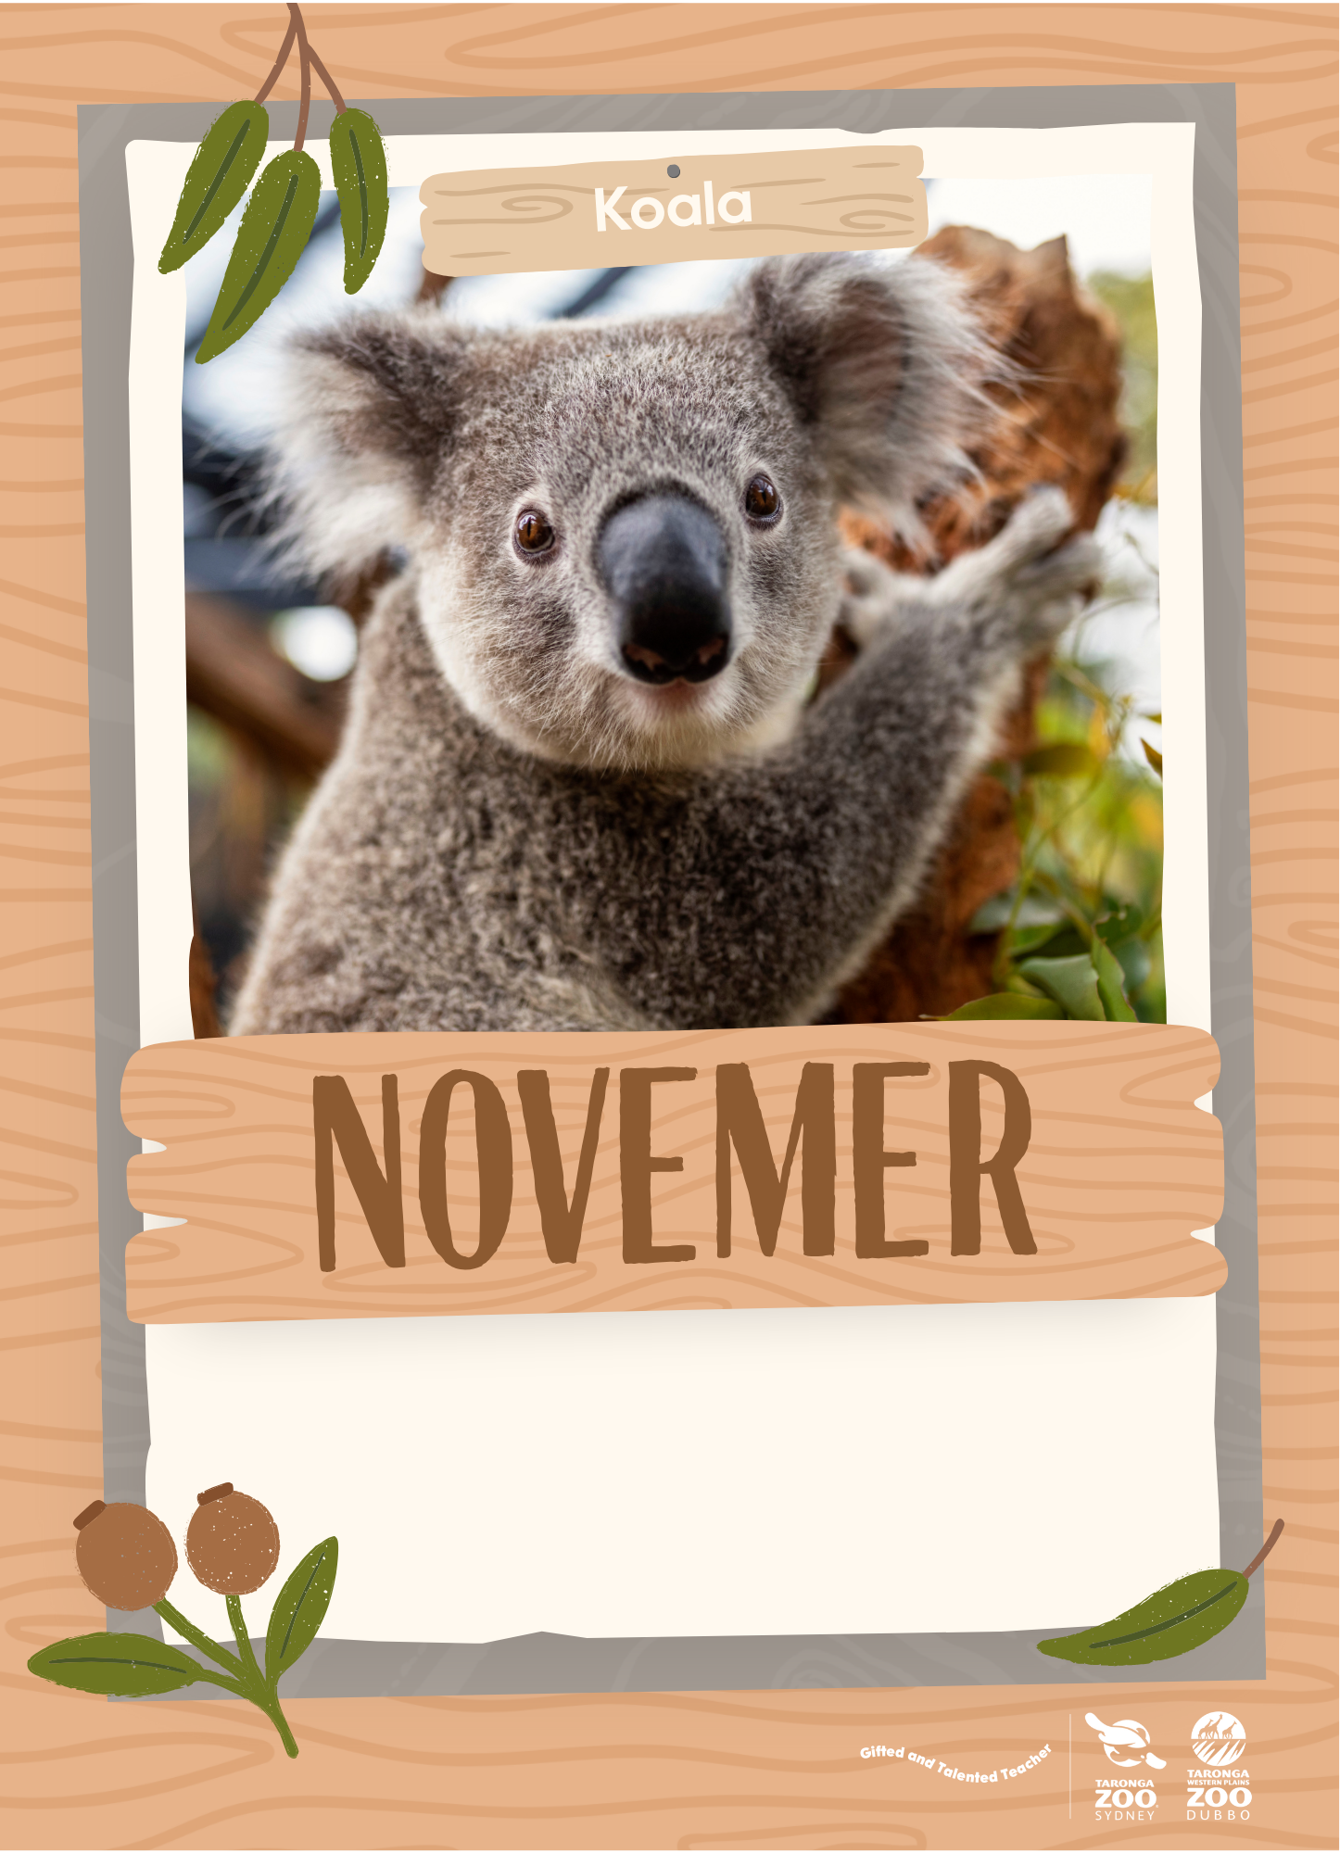
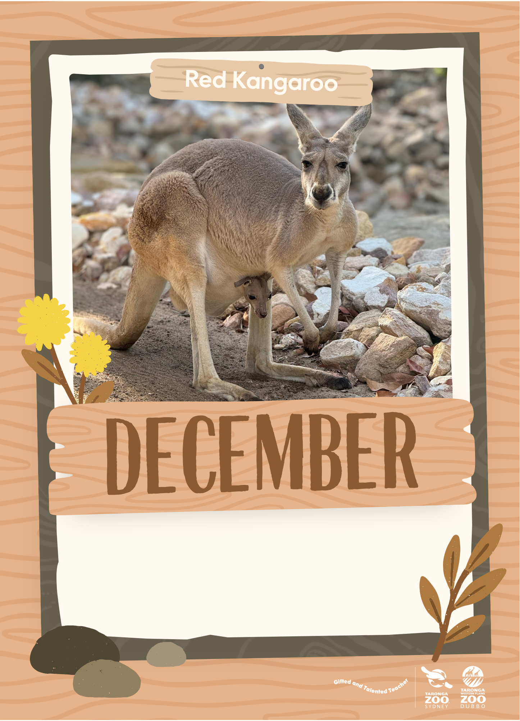

Slide 9
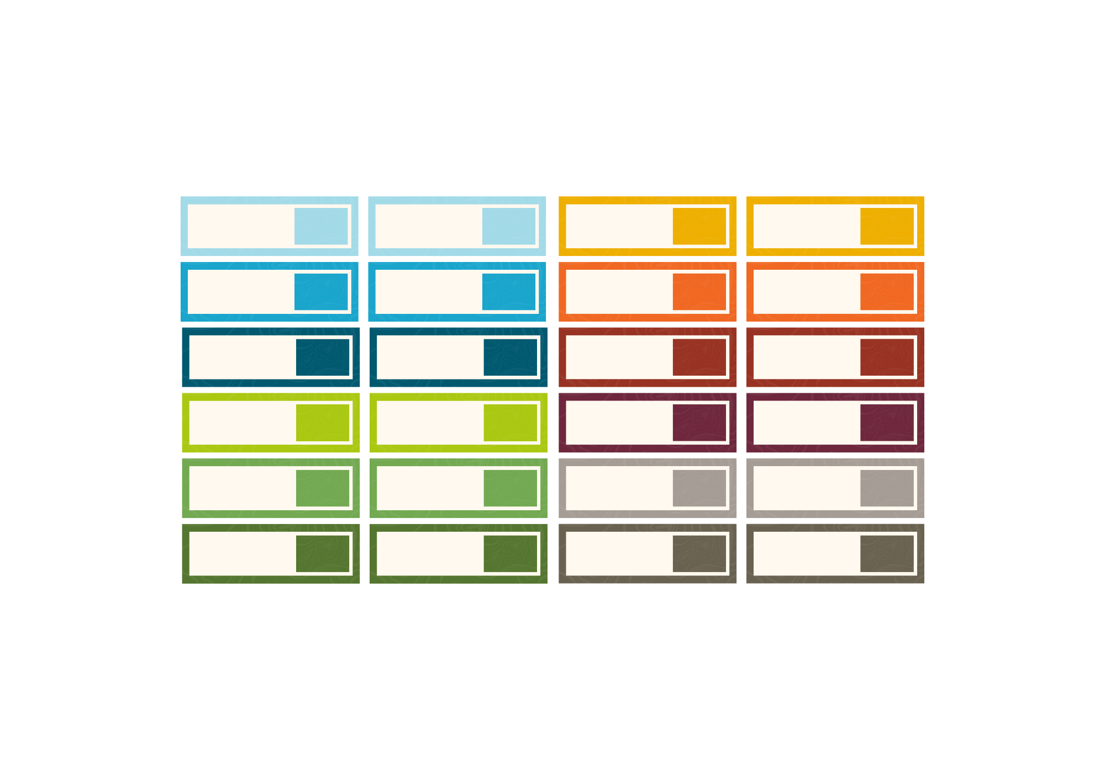
Name
0th
Name
0th
Name
0th
Name
0th
Name
0th
Name
0th
Name
0th
Name
0th
Name
0th
Name
0th
Name
0th
Name
0th
Name
0th
Name
0th
Name
0th
Name
0th
Name
0th
Name
0th
Name
0th
Name
0th
Name
0th
Name
0th
Name
0th
Name
0th
Match the colour tab to the month! Duplicate pages, as needed.

